Slide 1


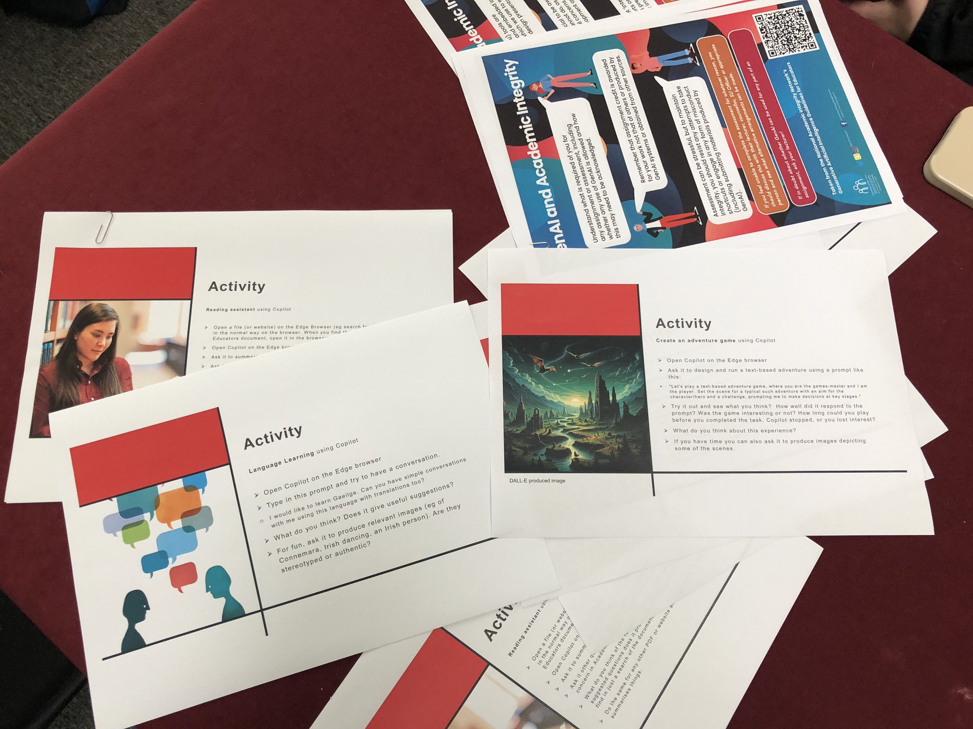

Gen AI Workshop
Workpackage 3: Staff-Student Partnership Activities
Staff – Student Partnership
1st Pilot Workshop
60 sign ups
30 attend/14 staff
Format: presentation+ 'hands-on'
Successful event
Series to follow
Centre for Excellence in Learning & Teaching

Slide 4
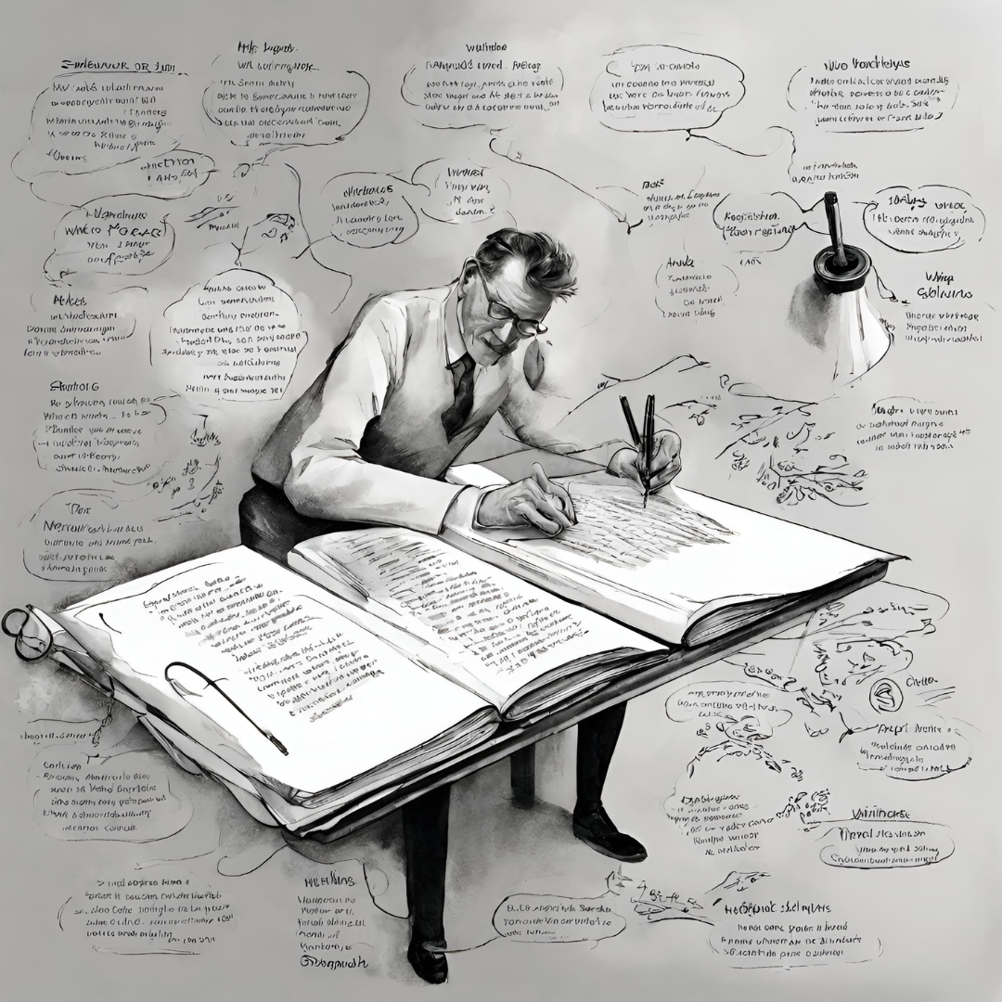
Gen AI in Academic Writing
Workpackage 3: Staff-Student Partnership Activities
Writing as thinking
Staff
Postgraduate & Research Students
Centre for Excellence in Learning & Teaching

Slide 5

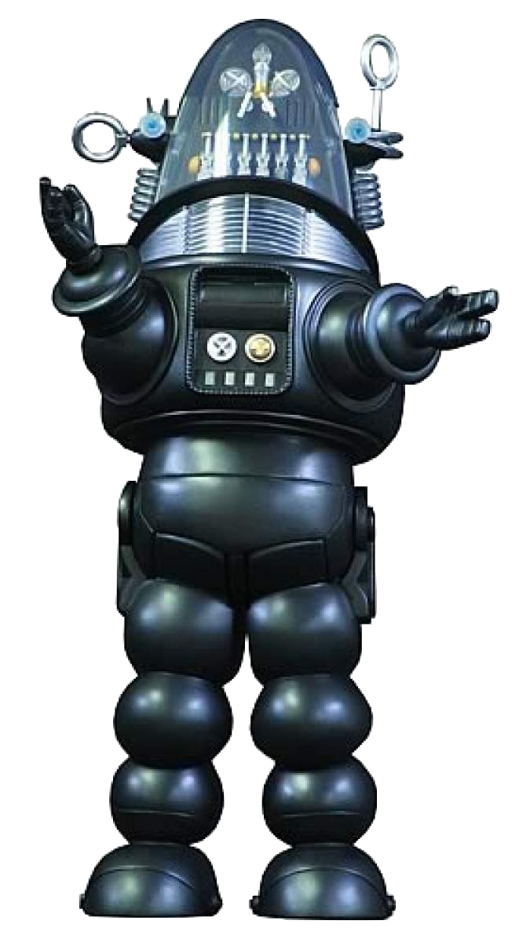
Metaphors mix-up meaning
Are we really describing what these systems are or are we endowing them with more capability than deserved because of what we call them?
Intelligence? Autonomous? Sentience?
Science fiction? Anthropomorphism?
Notes:
Can cloud our judgement...enthusiastic optimism....we want something to be better than it actually is

Slide 6
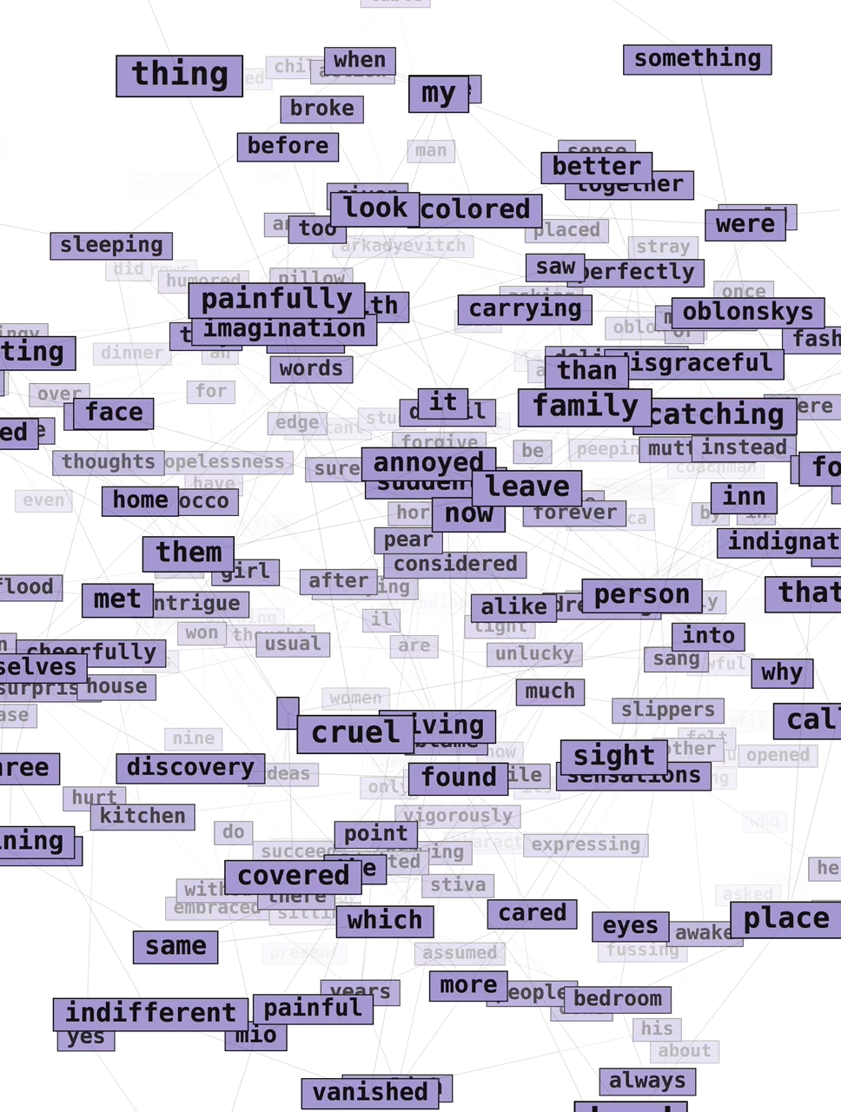
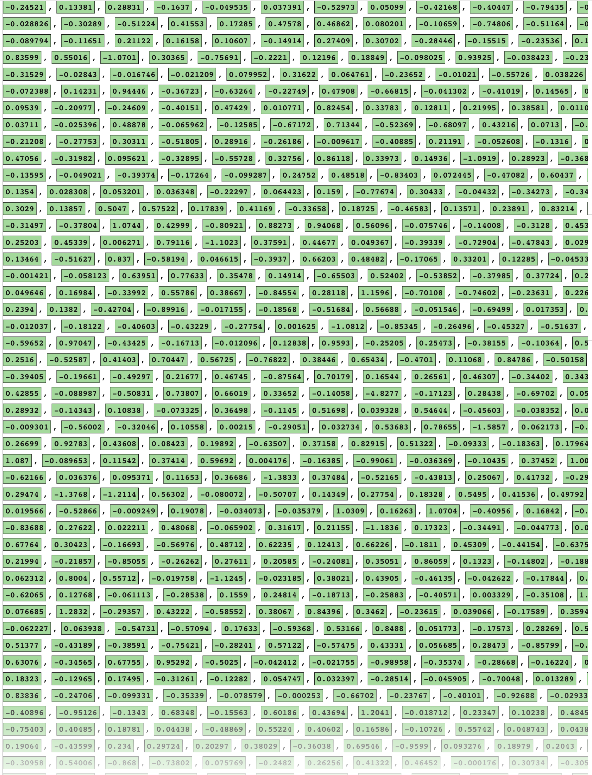
From the Guardian, technology section, Nov 2023
Generative AI doesn’t ‘understand’ words, it converts them into ‘tokens’ and creates numerical vectors that show the connections between these tokens across the data it has been trained on.

Slide 7

Issues
Limited information about ‘Training Data’ and processes
Significant resource demand
Prone to unpredictable error and fabrications
Quality of output deceptively high, yet often actually bland, limited, unimaginative
Unethical use
Notes:
Clear examples of copyright breaches, hate-speech, abusive images, biased datasets, privacy breaches
Cheap labour used to screen hate materials, label content, refine responses
World supply of GPUs
Energy and cooling water demands
Placing AI research in hands only of a few large corporations
Equity of access and equality?
What level of trust, accuracy, balance?
High risk when embedding into other systems?
Often, a simple search is far superior to using AI tool for information gathering
Misinformation
Fraud, identity theft, etc

Slide 8

AI assisting or bypassing learning?
If it helps with tedious tasks, would it not be better for everyone to get rid of those tasks rather than just get AI to do them?
Do not use Gen AI to do assignments for you and then claim that it is all your own work. That's the same as paying someone else to do your work and is fraudulent.
More authentic forms of assessment? Different approaches to making sure the student has learned the subject?
What can it do that you would give to an untrustworthy, unimaginative assistant? You need to check its work and actually know the subject it is writing about to be able to do so.
Explore possibilities without being dazzled, think critically, be aware of its limitations, protect your data and ideas, and always live up to integrity and honesty.

Slide 9

Activity
Reading assistant using Copilot
Open a file (or website) on the Edge Browser (eg search for QQI NAIN GenAI in the normal way on the browser. When you find the GenAI Guidelines for Educators document, open it in the browser).
Open Copilot on the Edge browser
Ask it to summarise the document and specify what the main conclusions are.
Ask it other questions,eg who wrote this document, why is using GenAI of concern in Academic Integrity, or anything else you can think of.
What do you think of the results? How well does it answer? What additional suggested questions does it produce? Is it giving you anything you wouldn't find in just a search of the document?
Do the same for any other PDF or website and explore how well Copilot summarises things.

Slide 10

Activity
Language Learning using Copilot
Open Copilot on the Edge browser
Type in this prompt and try to have a conversation.
  I would like to learn Gaeilge. Can you have simple conversations with me using this language with translations too?
What do you think? Does it give useful suggestions?
For fun, ask it to produce relevant images (eg of Connemara, Irish dancing, an Irish person). Are they stereotyped or authentic?

Slide 11

Activity
Create an adventure game using Copilot
Open Copilot on the Edge browser
Ask it to design and run a text-based adventure using a prompt like this:
    "Let's play a text-based adventure game, where you are the games-master and I am the player. Set the scene for a typical such adventure with an aim for the character/hero and a challenge, prompting me to make decisions at key stages."
Try it out and see what you think? How well did it respond to the prompt? Was the game interesting or not? How long could you play before you completed the task, Copilot stopped, or you lost interest?
What do you think about this experience?
If you have time you can also ask it to produce images depicting some of the scenes.
DALL-E produced image

Slide 12

Activity
Designing Logos using Copilot (DALL-E)
Open Copilot on the Edge browser
Ask it to design a logo for DigiChamps
What do you think of the results?
Click on one of the images and then when it opens up, right-click and select 'Search the web for image'. Can you see similar examples? If a designer is credited, they won’t have been given any credit or payment by OpenAI when they trained DALL-E or ChatGPT!
Try again, giving Copilot more information about what DigiChamps is and how it works. Are the new versions better?
Play with other logos, again try image searching on the results, or just critique what it produces.

